Slide 1
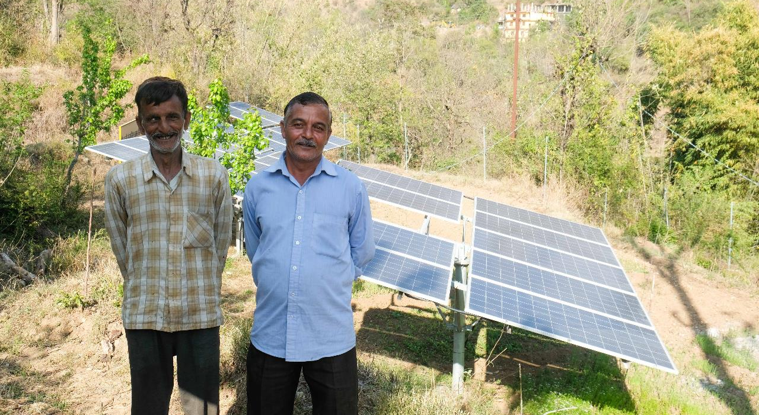
Solar-Powered Based Lift Irrigation Project
Village: Seri-Jeri, Dist. Solan, Himachal Pradesh, India
Supported by: Stitching Tulip Crowns
Photo: Solar Lift Irrigation, Village:Serwala, Darlaghat

Slide 2
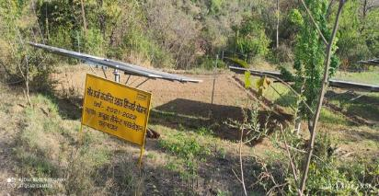
The Proposal – Agriculture – Solar Lift Irrigation
Problem:
Access to water for agriculture is an issue in hilly terrains like Himchal Pradesh
Convention power grid is often unavailable and become a costly to farmers
Solution:
Solar powered - Group Lift Irrigation System
Proposal:
To support a group of 20-25 farmers to install a lift irrigation system powered by solar energy in Himachal Pradesh.
Outcomes:
Irrigation facility for 20-25 farmers
Doubling crop intensity leading to increase in income to farmers
Crop production with clean renewable energy

Slide 3
Project Profile
Installation of Solar Powered Pumping System to provide Irrigation facilities to the farmers to enhance their income through crop diversification and planting orchards.
Process
Village-01
Project Cost
€ 18170
Project Design
Community Mobilization
Household- 23 nos
Stitchting Tulip Crowns
€ 13500
Baseline and Technical Survey
Total Population-150
Project Initiations & System Installation
Community and other
€ 4670
Total Area- 12.8 hectare
Project Completion and handover to community

Slide 4
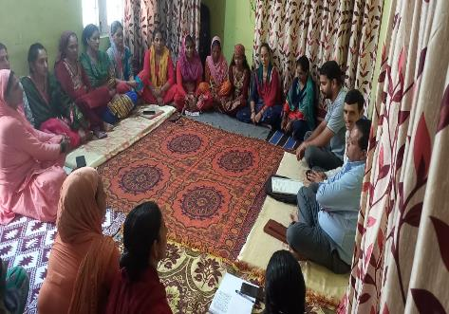
Progress
Mobilisation and Awareness Building among Communities - 05 Village level meetings
Ensured involvement of Gram Panchayat/ Village Institutions
It was decided by the communities to engage the “Kanwar Youth Club-Seri Jeri” to execute/monitoring the project in collaboration with ACF.
Secondary and Primary data has been collected
Crop Profile
Kharif Crop | Area in Hectare | Rabi Crop | Area | Uncultivable Area
Maize | 4.20 | Wheat | 3.60 | 4.44
Turmeric | 0.11 | Garlic | 0.01
Ginger | 0.17 | Potato | 0.09
Arbi | 0.18
 | 4.66 |  | 3.70 | 4.44
Village Meeting

Slide 5
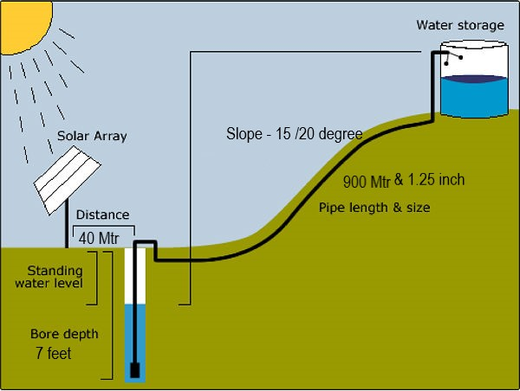
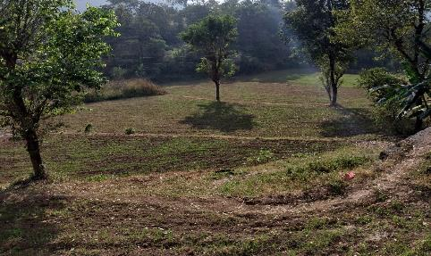
Cont…
Baseline and Technical Study
Identification of beneficiaries including crop wise data/land holding
Technical study of the area conducted by involving experts
Rising main (main pipeline) and distribution system design including estimation of storage tank has been completed.
Area to be irrigated

Slide 6
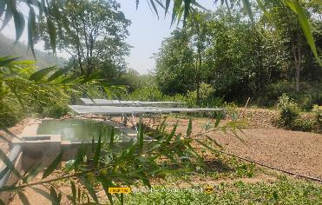
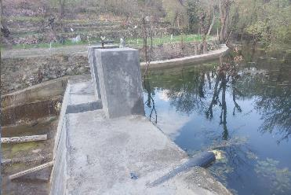
Cont..
Water Tank along with the Check dam reservoir has been constructed from where the water will be lifted.
The supply order for providing and installation of Solar based equipment's has been released to the vendor “Standard Tech”
Installation of Solar Panels including other equipment's will be initiated by the end of November.
Project installation will be completed by 25th December 2023.
Inaugural and Commissioning of project by 31st December 2023.
Water Tank
Check Dam

Slide 7
Schneider Linkages
Items | Make and Model | Remarks
Variable frequency drive 12-18 AMP, 400 volts, 3 phase output and control MCB with other electric connector on & off switch control, surge protection system including providing with suitable size MS box with powder coat paint | Schneider | Order Placed
Solar PV Module Mono 540 Watt | Luminous | Order Placed
All other items like Pipes & Fittings, Pump, Cable etc procured from available brands locally as Schneider is not dealing on those items.

Slide 8
THANK YOU

